Slide 1

Project 3 Data612 Matrix Factorization methods
SVD Recommendation System on MovieLens Datasets
Jun Pan

Slide 2
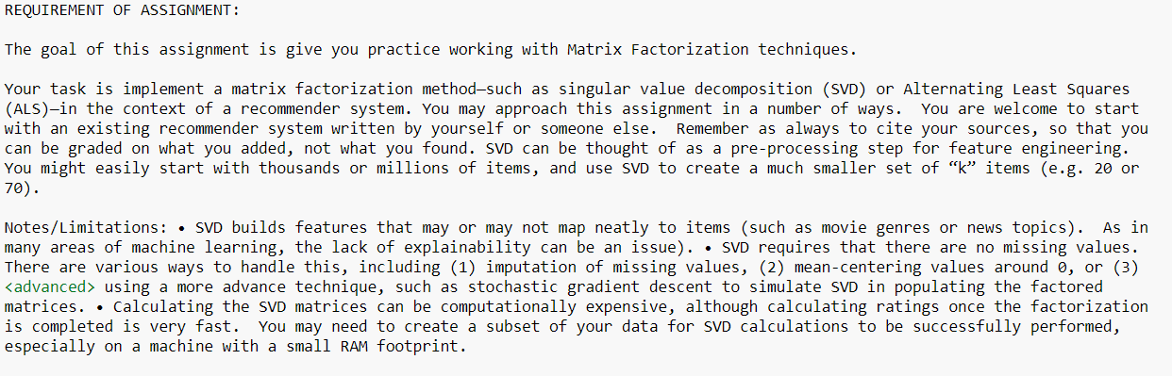
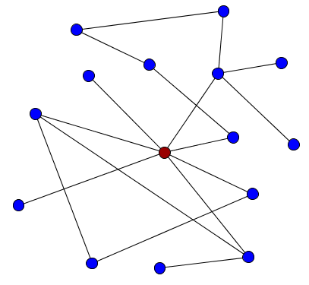
Requirement

Slide 3
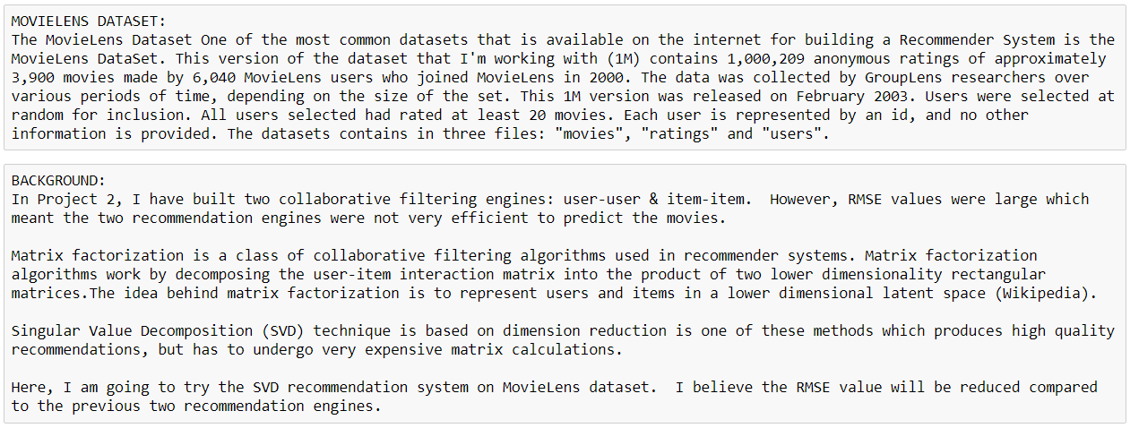
Background Information

Slide 4
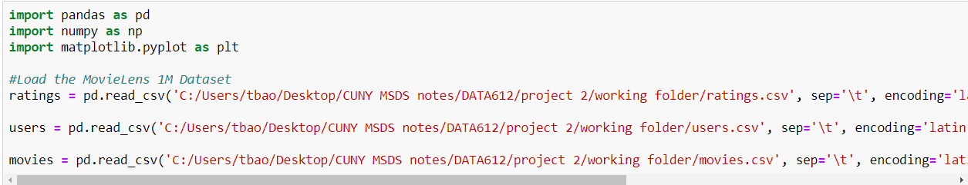
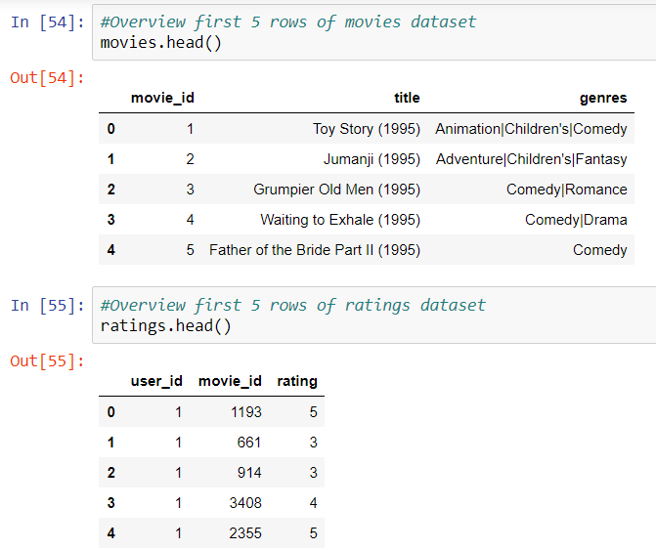
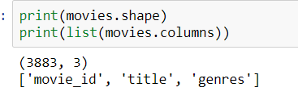
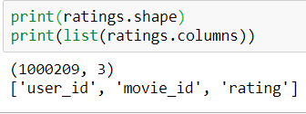
Load and Overview Dataset

Slide 5
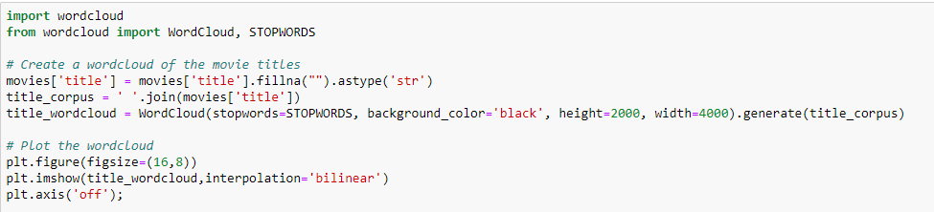
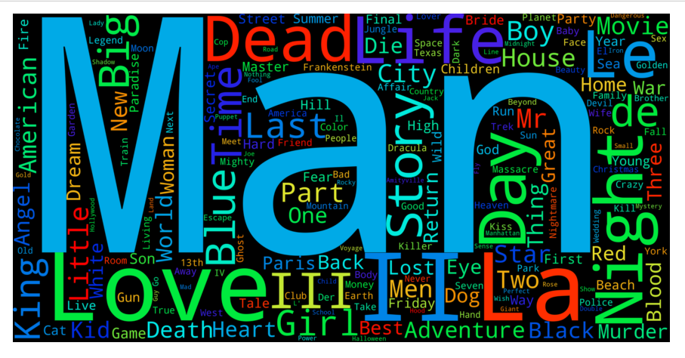
Word Cloud Plot for Title Words

Slide 6
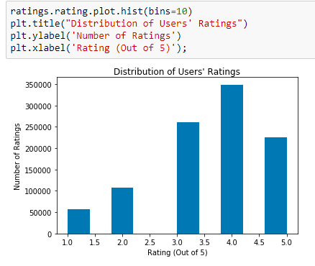
Histogram of Rating

Slide 7
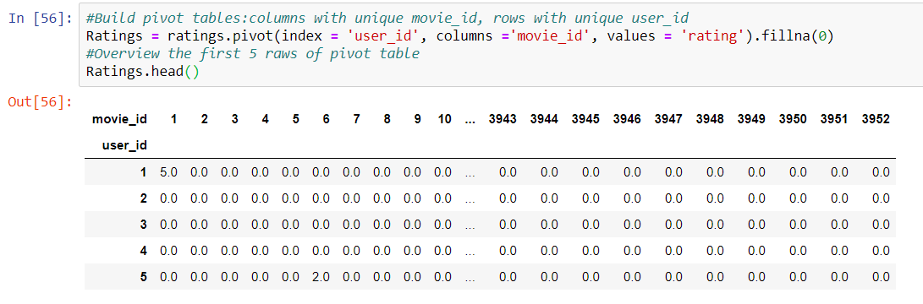
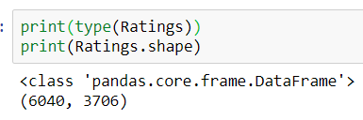
Build Pivot Table Each row represents unique user_id Each column represents unique movie_id

Slide 8
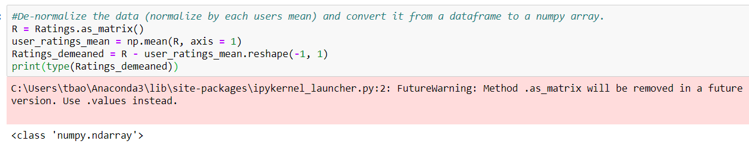
De-normalize data and convert to a numpy array

Slide 9
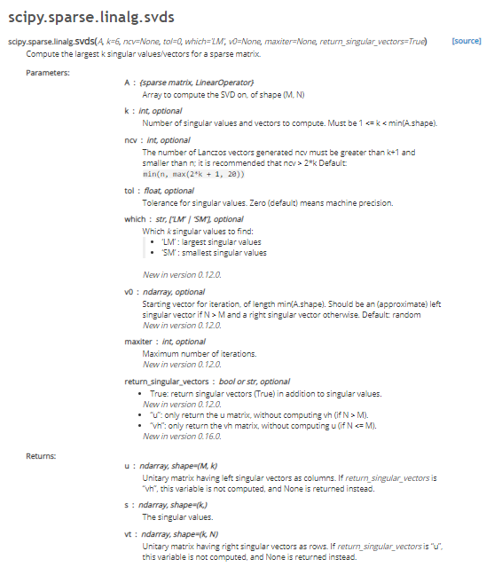
SciPy Reference Guider

Slide 10
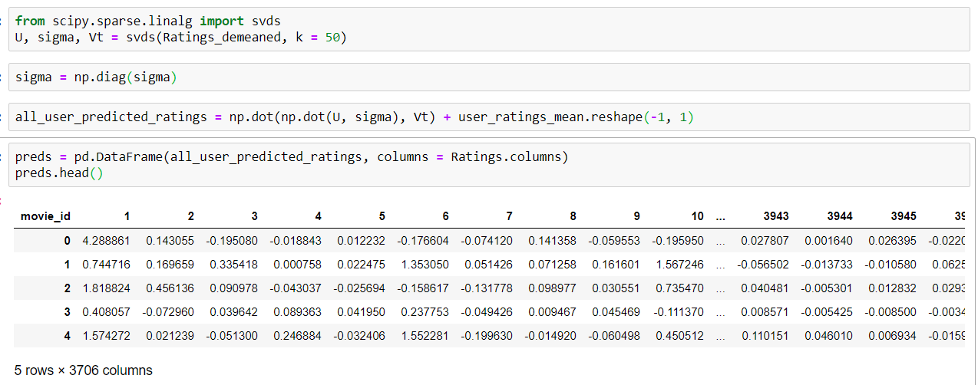

Get predict matrix for every user

Slide 11
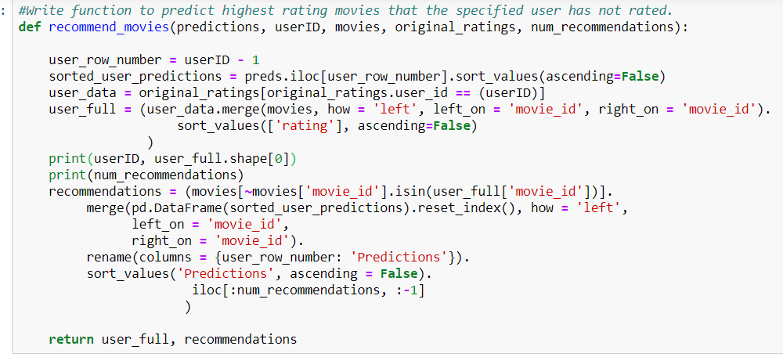
Write function for prediction of top rated movies

Slide 12
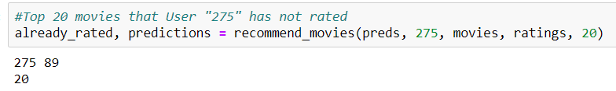
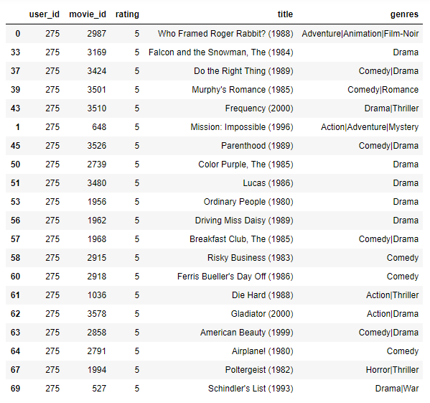
Example: user 275 will like 89 movies which he/she has not rated. Among it, we show top 20 movies.

Slide 13
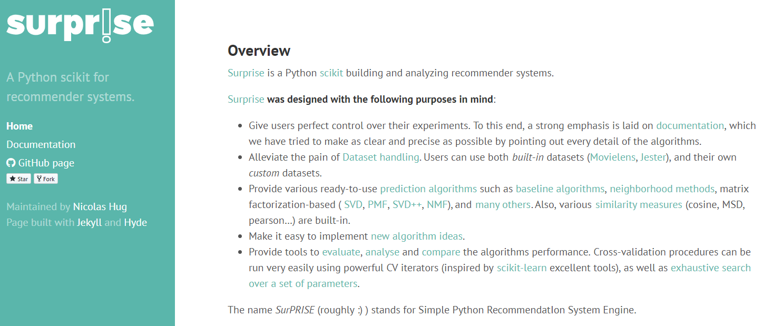
Using Surprise Library to Evaluate SVD Model

Slide 14
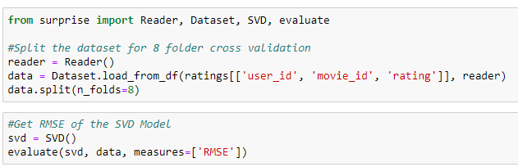
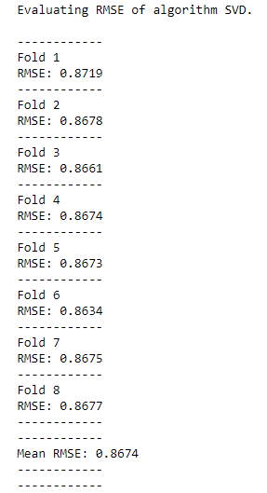
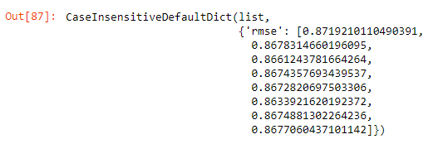
8 folder cross validation of SVD model

Slide 15
Conclusion
In Project 2, user-user and item-item collaborative filtering models have very high RSME valuse (>1000).
RSME of SVD model with RSME score of 0.8674.
In Project 2, we only used 1% of MovieLens data. Using more than 4% of data, the computer will be dead.
Using SVD model, we used 100% of MovieLens data. The time for computation is about 10 minutes which is reasonable.
Therefore, SVD model is a much better model.

